Slide 1
Introduction to State
React

Slide 2
Contents page
States in React
Initialising a State
Interacting with States
Debugging

Slide 3
Objectives
Discuss what a state is and it’s uses.
Explore how we initialise and interact with states in React.

Slide 4
States in React
States are used to store a components dynamic data.
It allows the component to keep track of changing information in between renders.
Key Point: When the state is updated, render is called to update the component.
React states are attached to each component – There are multiple component states in a project.

Slide 5
States in React Cont.
Unlike props, states are:
Mutable – they can be changed.
While this.state is immutable, you modify a copy of it with setState(). This lets us keep track of changes.
Controlled solely by the component it is initialised in, not the component passing it down.
Only usable in class components – Can’t be used in function components.
States should be used to store component data that changes over the components lifecycle.

Slide 6
Initialising a State
States can be initialised per component.
States can only be used in class components. Function components need to be converted to classes to use it.
To set the initial state of a component, update this.state in the components constructor.
constructor() {
super();
// Initialising the state
this.state = {
clicked: false, clicks: 0
};
}

Slide 7
Interacting with States
Think of this.state as an object; you can read values from properties just like any other.
EG: const x = this.state.propA;
Updating the state however is different.
State should never be updated explicitly.
Instead, use this.setState().
setState takes in an object that is a partial state. This means you can update more than one property at a time.
EG: this.setState({propA: 1, propB: 2});
addClick() {
this.setState({
clicked: true,
clicks: this.state.clicks + 1
});
}
Notes:
If we were to update this.state directly the component wouldn’t re-render. That’s because the state wouldn’t be able to detect the change.

Slide 8
Interacting with States Cont.
Any method that uses the state needs to be bound to this to access it.
This is done with this.myMethod.bind(this);
This is commonly done in the constructor, but can also be done when calling the function.
EG: this.myMethod.bind(this, ‘example arg’);
Alternatively, declaring the function in the constructor with the arrow syntax avoids this.
This can be more suitable for smaller operations.
// addClick is a function that uses state
this.addClick = this.addClick.bind(this);
// Declaring functions in the constructor
// avoids the need for bind()
this.resetClicks = () => this.setState(
{ clicks: 0}
);

Slide 9
Combined state Example
export class MyComp extends Component {
constructor() {
super();
this.state = { clicks: 0 };
this.addClick = this.addClick.bind(this);
}
addClick() {
this.setState({clicks: this.state.clicks + 1});
}
render() {
return (
<button
onClick={this.addClick}>
Clicks: {this.state.clicks.toString()}
</button>
);
}
}
Initialising the state with default values
Bind any method you want to use state in
Using setState() to update a property
Accessing state data from this.state

Slide 10
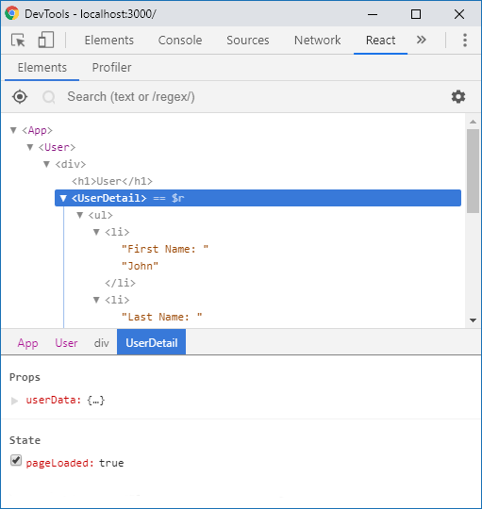
Debugging
React Developer Tools is a Chrome extension that allows you to debug React apps more efficiently.
It allows you to monitor and manipulate state data on a component by component basis, updating the component in real time.
Notes:
Extension: https://chrome.google.com/webstore/detail/react-developer-tools/fmkadmapgofadopljbjfkapdkoienihi?hl=en

Slide 11
Practice Activity
Directions:
Time: 15 minutes
Create a component that displays a static timestamp. Store this time in a state.
When a button is clicked the time is updated to the current time. The time should default to the time when the page is loaded.
Use React Developer Tools to monitor how the state is changed when the button is clicked.
Debrief:
Discuss how the state updates the component dynamically.

Slide 12
State or Props?
Data
Events
If something could be taken from both state and props, it should probably be in props.
If more than one component use state that has similar/the same data in it, pull them up to the closest parent component and pass it down via props.
Each piece of data should have a single source of truth.
Changing state in a parent component will cause child components to be re-rendered.
Component
Component
Component
Component
Component
Component

Slide 13
Summary
Discuss what a state is and it’s uses.
A state used to store dynamic data for a React component.
It’s mutable (with caveats) and controlled by the component it is initialised in.
Explore how we initialise and interact with states in React.
States are initialised with default values in a components constructor.
Accessing data is achieved through this.state, updating a state is achieved through this.setState().
You need to use bind() when creating methods that use the state (unless you declare them in the constructor).

Slide 14
Thank you for listening.

